Slide 1
NEWYORK CITY

Slide 2
NEW YORK CITY
The New York City traces its origin in the year 1626 by the Dutch who bought Manhattan Island which had been occupied by the Native Americans.
It was renamed the Colony New York.
In the 18th century, New York City gained its prominence because it was one of the major port of trade and marketing within the thirteen colonies.

Slide 3
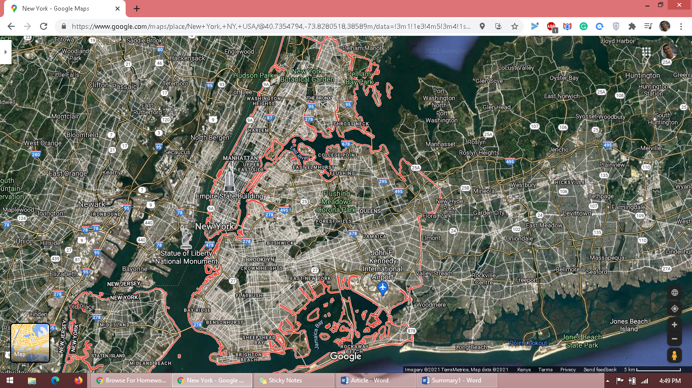

Slide 4
Shape of the New York City
Nuclei shaped
The New York City has been divided in to various classes, the service class, working class and the creative class.
New York assumed its shape after the Vermont becomes its own state in the year 1789 and the Massachusetts and Connecticut expanded to the west.

Slide 5
Ease of navigation
The New York has straight grid but the orientation tend o be off-center from the cardinal direction.
The quickest and easiest mode of travelling in the New York City is by using subway.
Various address of buildings can be used to identify various avenues.
The New York eastern and western streets are divided by the fifth avenue.
In the New York City, the streets with odd-numbers head to the west and those with even numbers head to the east.

Slide 6
Specific historical events that shaped the city
The following are the various historic events which has shaped New York city
1609- Arrival of the European. Henry Hudson claimed the land in the New York city for the Dutch.
1624- The Dutch people built Fort Orange which become the city of Albany.
1664- The British took over the Netherlands and it was renamed New York City.
1775- American Revolution which took place in the New York City
1778- New York became the 11th state.
1929 - The New York Stock Exchange crashed thus signaling beginning of Great Depression.
2001- Twin Tower crashed by terrorists

Slide 7
Where is it now?
The New York City’s economy lies greatly in its role as the headquarters of the United States financial companies.
Various financial industries have their headquarters in the New York City.
Due to restructuring in the United States, there has been an increase in the menial jobs and low middle class jobs.

Slide 8
Future trends
Adaptability and the workforce productivity.
Low taxation
Climate change
Increased gap between rich and poor
Technological Advancements
Unemployment due to increase utilization of Artificial Intelligence

